Slide 1
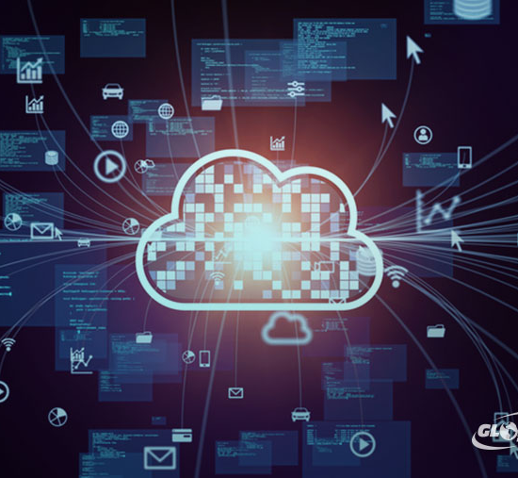
Setting Up Personal Home Cloud

Slide 2
Supervised by:
Team Members:
Prof. Dr. Tarek salah
T.A. Omnia Ahmed
T.A. Riham Fares
Suhayla Abdulrahman Younis
Mohamed Samy el nakhal
Abdelkhalek Mahmoud
Youssef Karam
Mohamed Soliman
Kareem Mohamed
Hady Khater

Slide 3
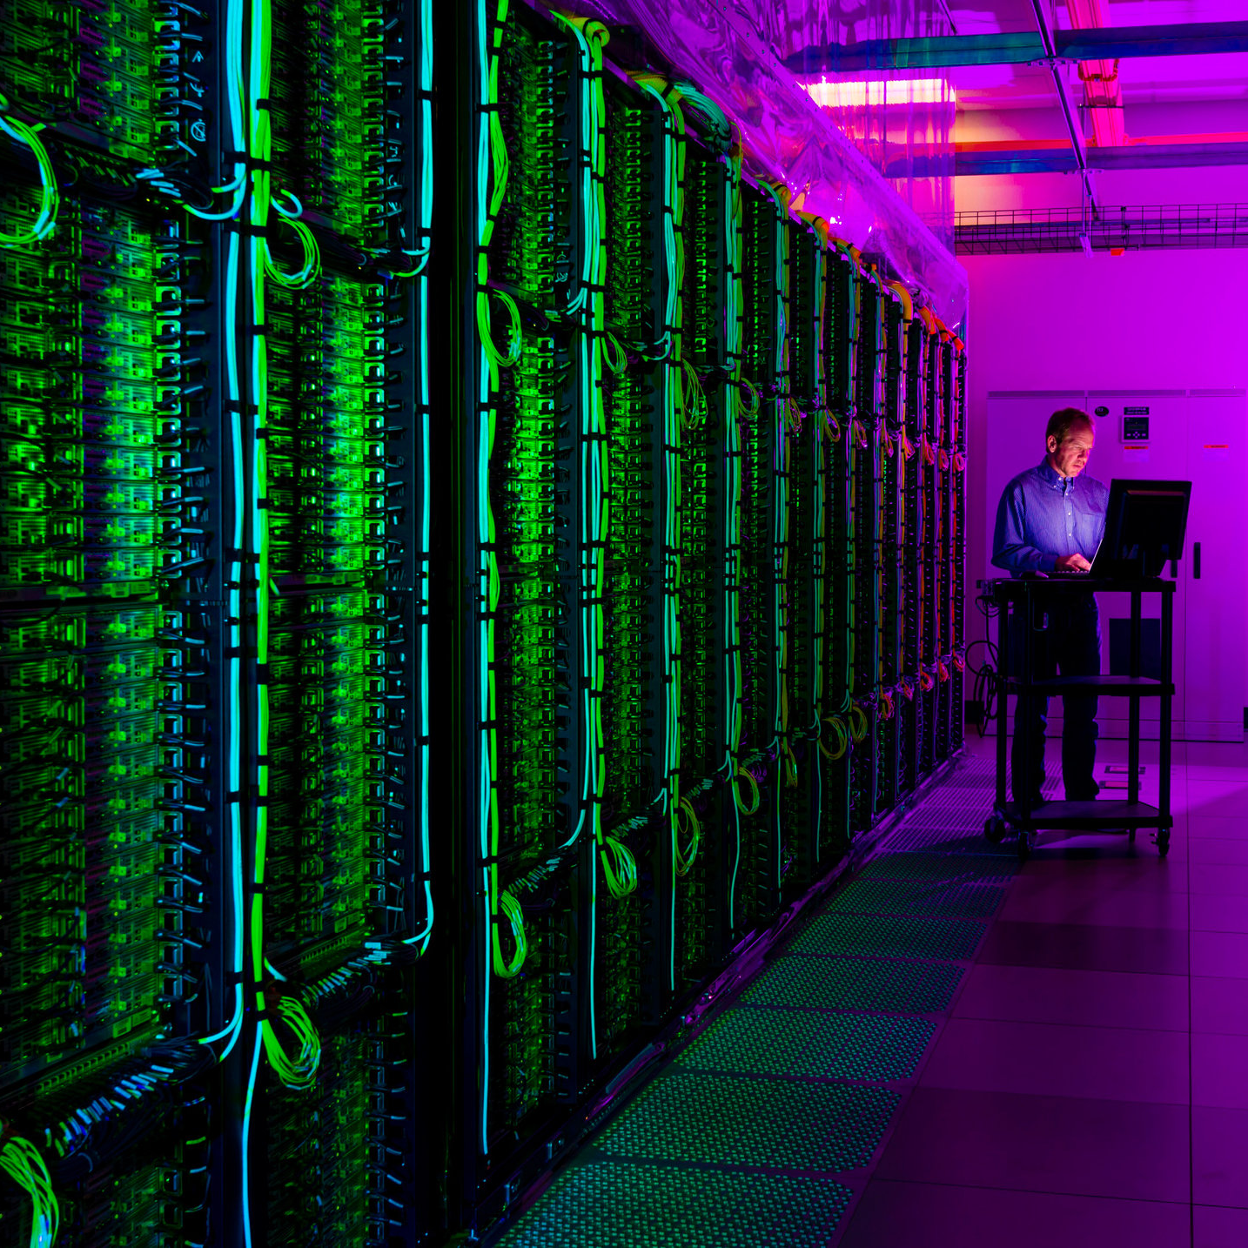

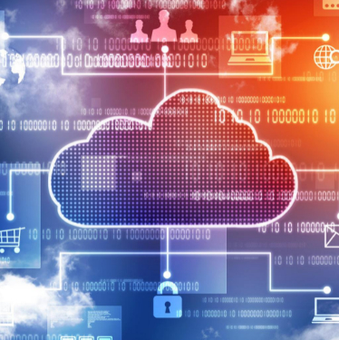
Agenda
Problem definition
Introduction
Objective
Expected time plan
Survey & literature review
Similar products
Analysis
Tools / Technology
Design
References.

Slide 4

Problem Definition

Slide 5

It is certain that families collect their memories through photos/ videos/ music or even text documents and storing such files may require a huge storage and of course family members would want to access those files from anywhere . So, it’s needed to have a system that is designed to have a central storage for all media files that are already available or stored on different devices, so that these files are accessible to them.

Slide 6
Problem definition:
The limited amount of storage provided from known cloud services (e.g., iCloud, dropbox etc..).
The prohibitive costs of cloud storage services.
The lack of security of cloud storage services.

Slide 7
Introduction

Slide 8
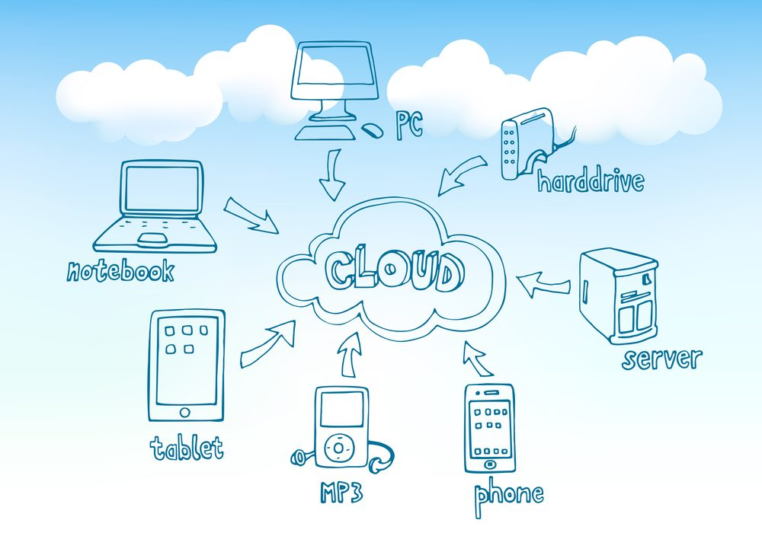
Introduction
Most of the cloud computing services are costly and provide limited storage to users, at the same time the risk of your data to store at third party is a big issue, to overcome these problems this project will come up with the perfect solution with unlimited cloud data storage by the help of “Raspberry Pi”.
Rather than store all our media and files on a cloud server in an unknown location, we can keep a cloud at our home and make it personal as the data will be stored in your external hard drives connected to the Raspberry Pi.

Slide 9
Objective

Slide 10
Objective:
Provide a solution software where user can control the amount of storage used and upgrade to higher storage when needed.
Create a cost-free software so that user is provided with the same features provided by known cloud services (e.g., iCloud, dropbox etc..) without having to pay money for it.
Assuring That the system is completely secured as the storage devices (hard disk drives) are completely in control of the user.

Slide 11
Expected Time Plan

Slide 12
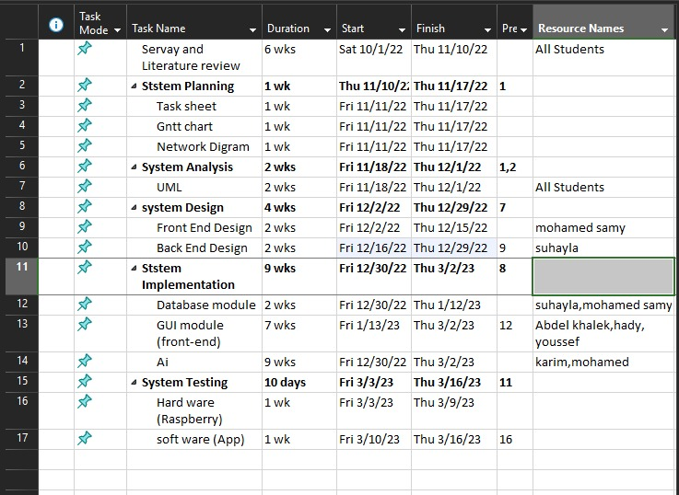
Planning

Slide 13
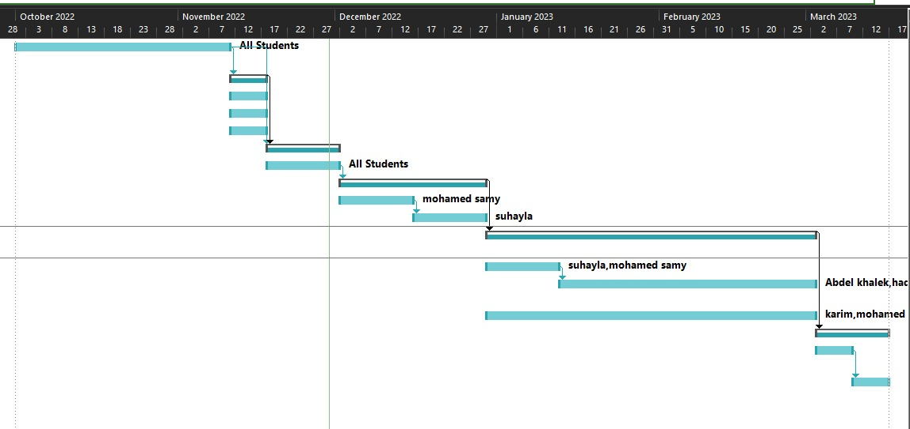
Planning

Slide 14
Survey & literature review

Slide 15
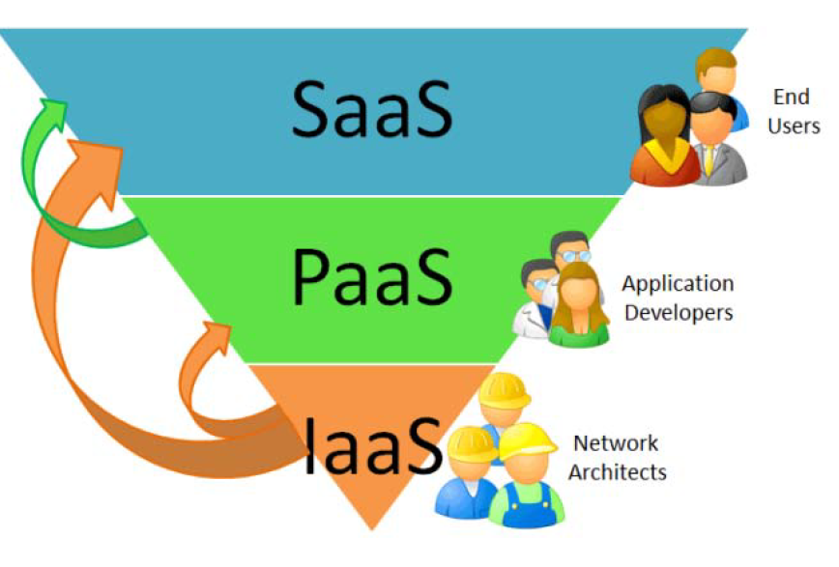
Literature review:
According to William (2014), in order to do
effective way of computation, Cloud Computing offers IaaS, PaaS and SaaS levels of service models.
Cloud Computing Stack

Slide 16
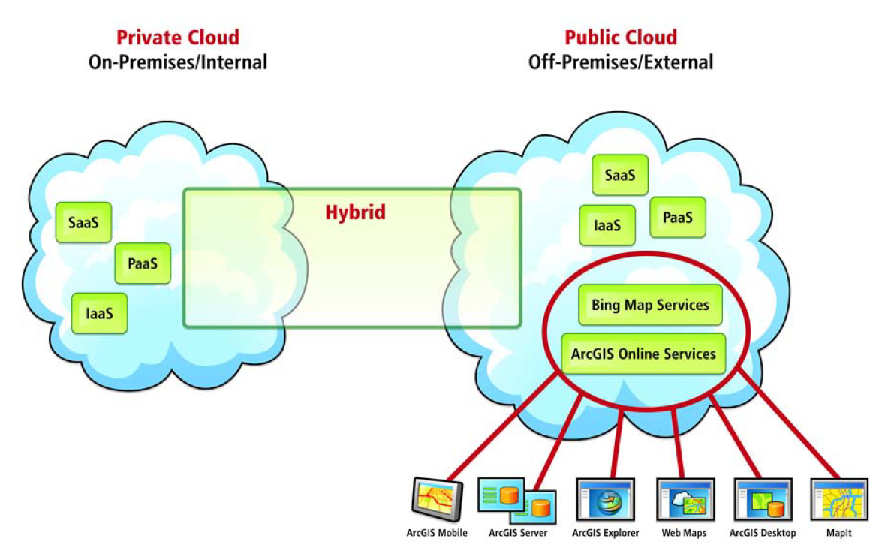
Cloud Computing deployment Models:
i. The Public Cloud
Public cloud computing is based on large-scale
offering to general public, the infrastructure is located at
premises of provider. The provider owns and manages
the cloud infrastructure.
ii. The Private Cloud
In this case the infrastructure is provisioned for
exclusive use by a single organization. It can be owned,
managed, and operated by the organization
themselves, a supplier as a third party, or some
combination of them.

Slide 17
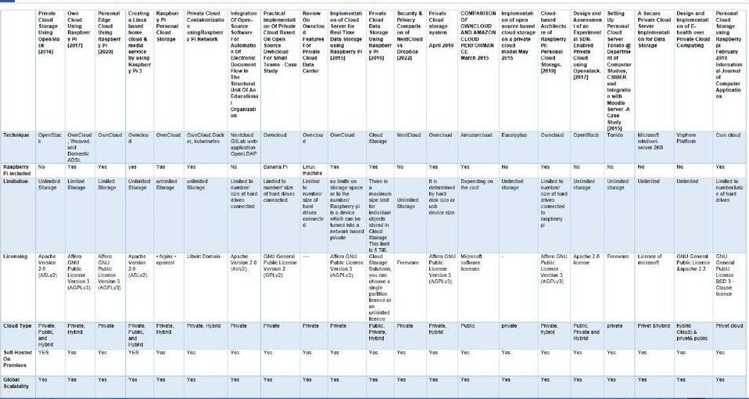
Survey :

Slide 18
Similar Products

Slide 19
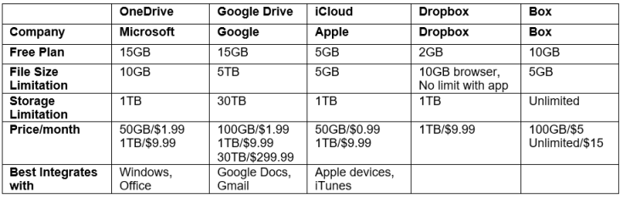
Similar products:

Slide 20
Analysis

Slide 21
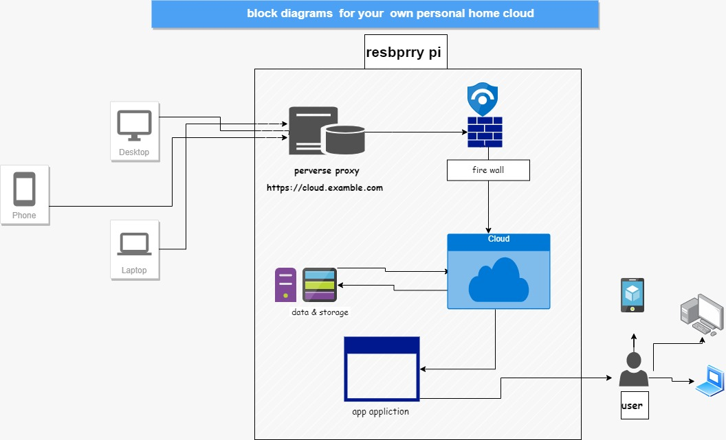
Block Diagram:

Slide 22
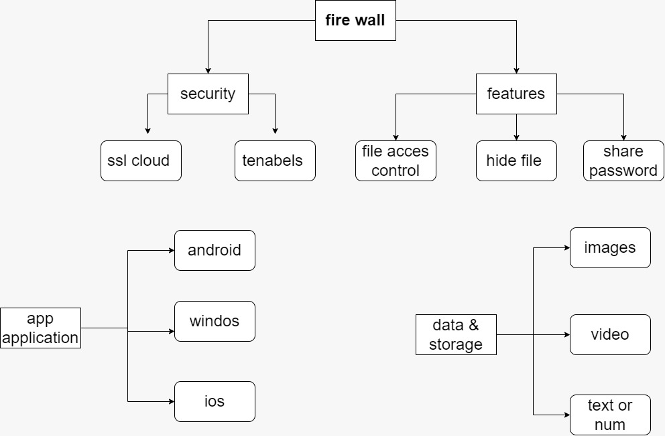
Block Diagram:

Slide 23
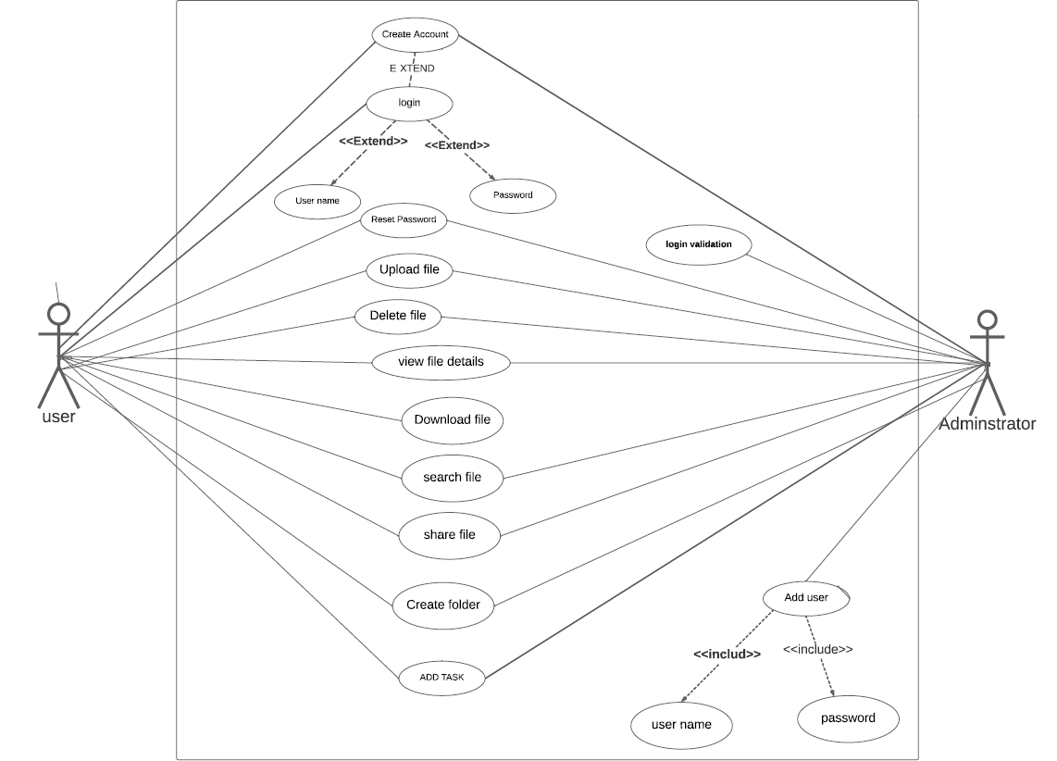
Use case:

Slide 24
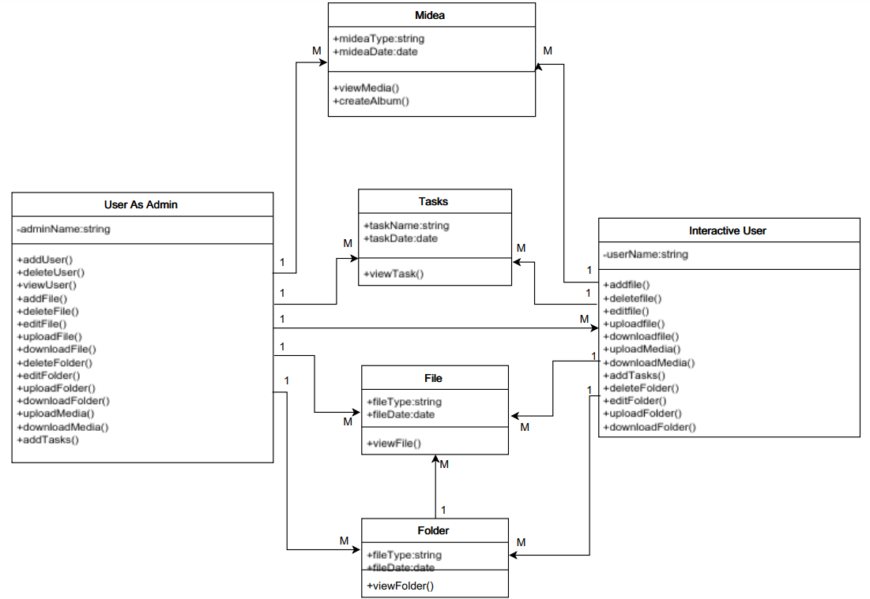
Class diagram:

Slide 25
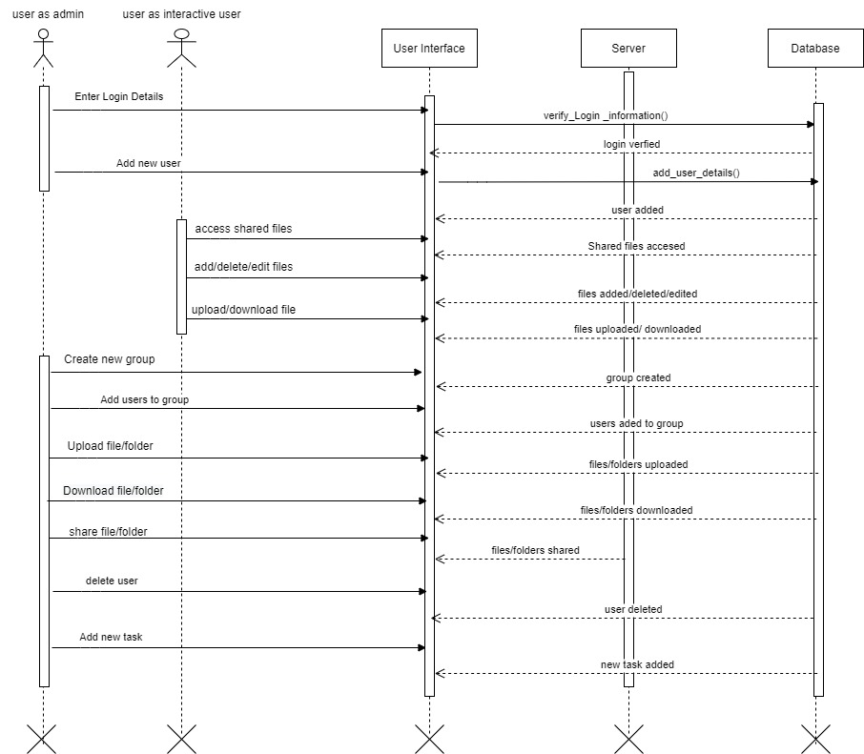
Sequence diagram:

Slide 26
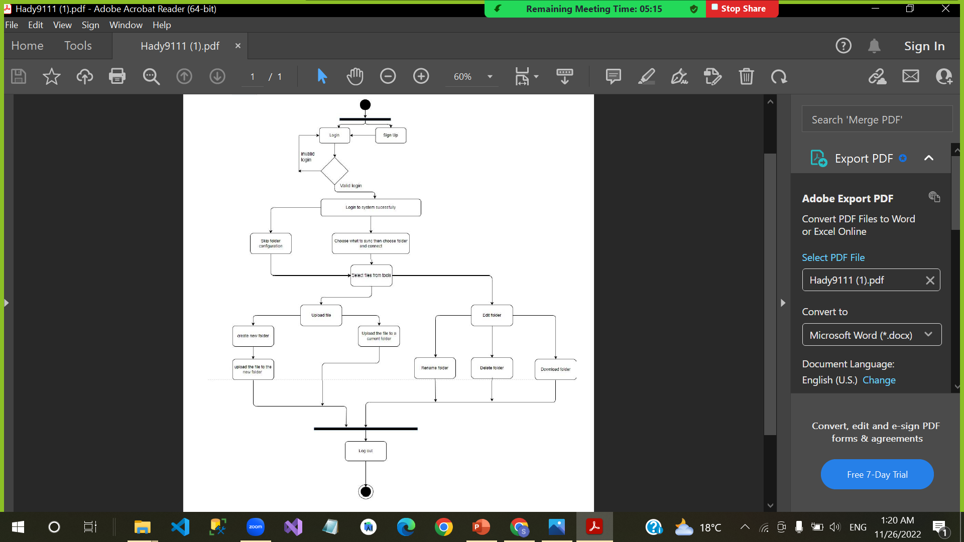
Activity diagram:

Slide 27
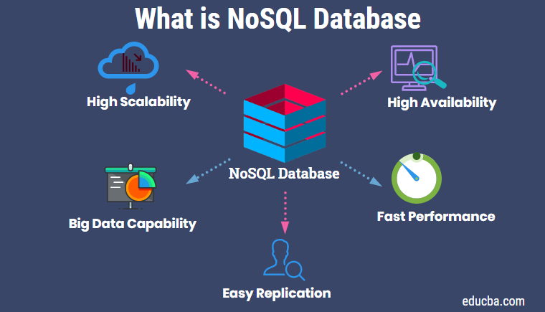
Data Base:
In this project we will use NoSQL Database due to different reasons:
The ability to handle a variety of data types.
Higher performance.
Ideal for unstructured and semi structured
data, such as text, images, audio and video

Slide 28
ER diagram:

Slide 29
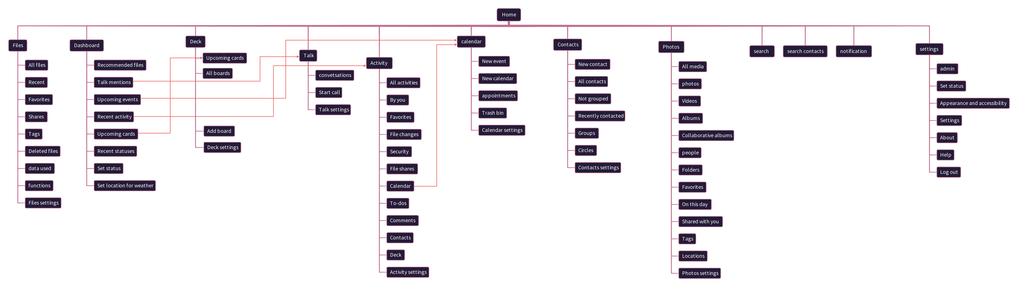
Site Map:

Slide 30
Tools/ Technology

Slide 31
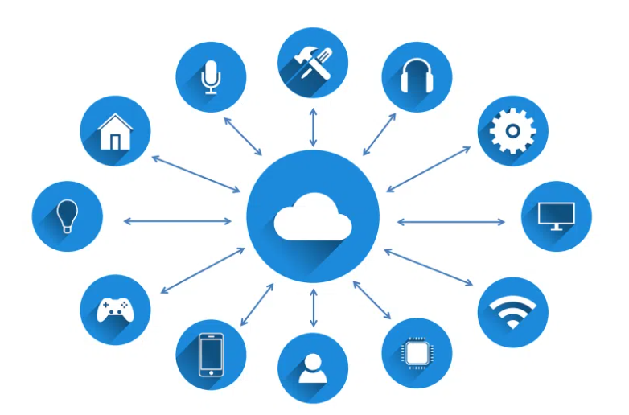
Technology:
The technology used in our project is Cloud computing technology as it gives users access to storage, files, software, and servers through their internet-connected devices: computers, smartphones, tablets, etc.

Slide 32
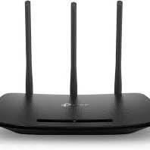
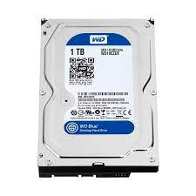
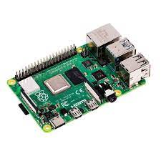
Hardware tools :
Raspberry Pi.
Hard Disk Drive.
Router and stable Internet connection.

Slide 33
Tools:
Programming languages:
JavaScript
Dart
Frame works:
Flutter
Node js.
Operating Systems:
Linux
Prototype:
Figma

Slide 34
Functional Requirements:
Non-Functional Requirements:
This project must enable user to access files over
the internet.
Allow user to make transactions on files (upload/Download/update/ delete) files.
The system must be cost free.
The system must be easy to use and not complicated.
The system must have high security.
System must have high maintainability.
System must be reliable.
System must have high security.

Slide 35
Design

Slide 36
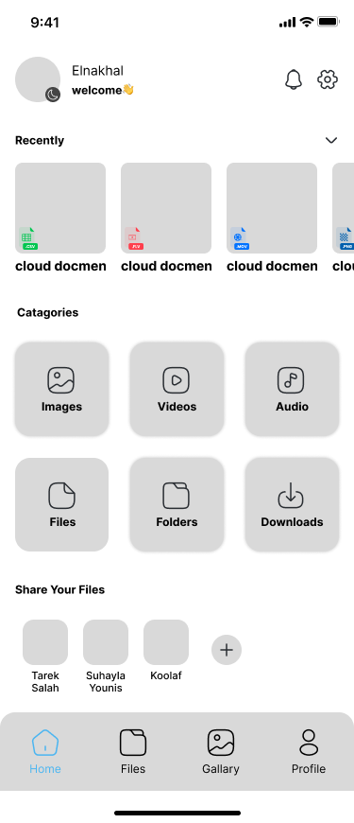
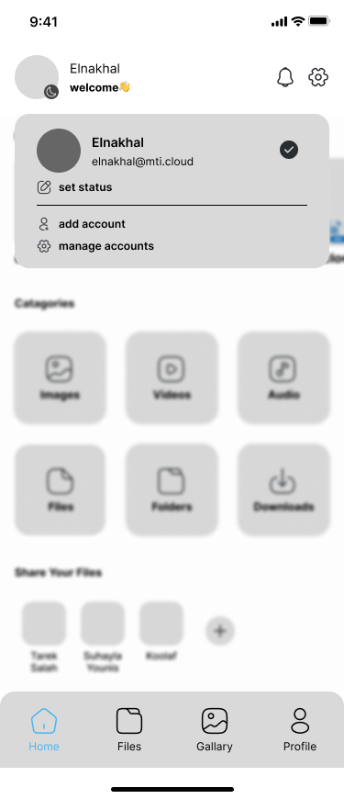
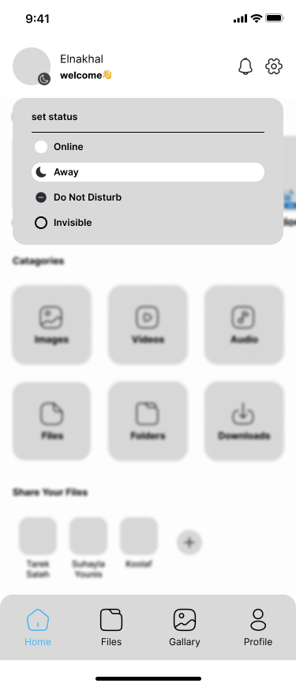
Prototype

Slide 37
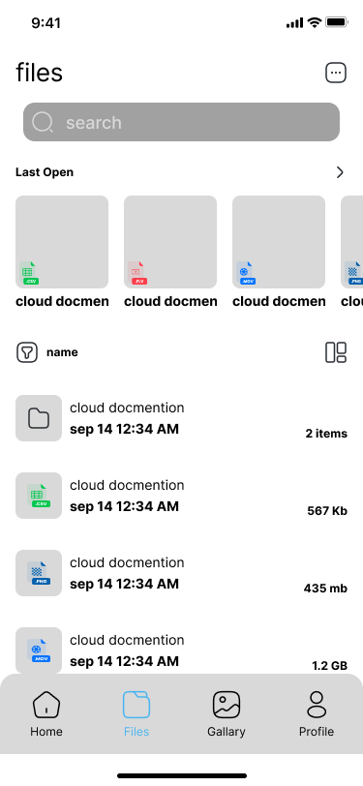
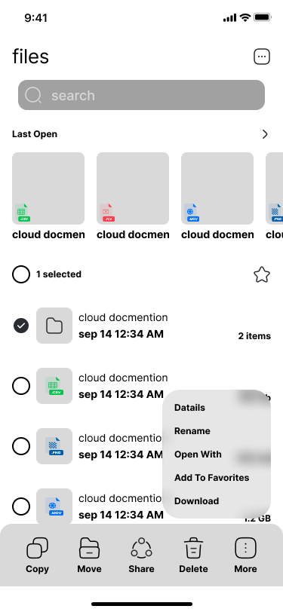
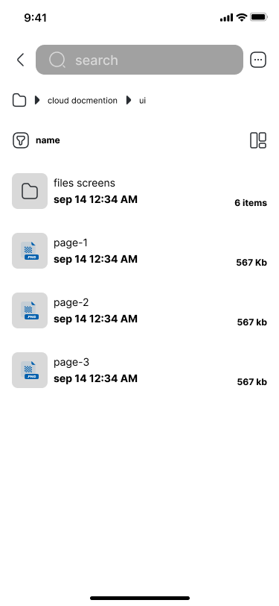
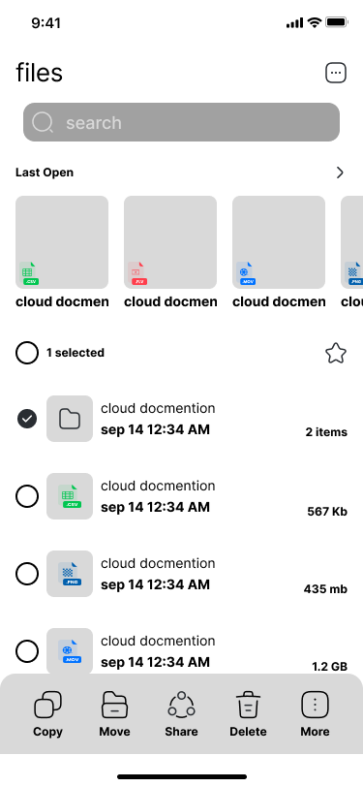
Prototype

Slide 38
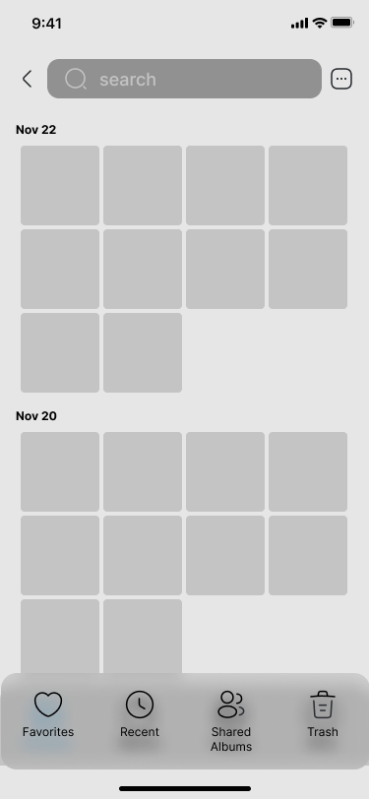
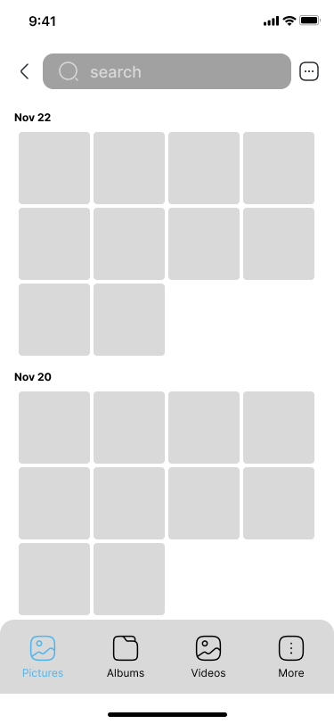
Prototype

Slide 39
Front-End
Design:

Slide 40
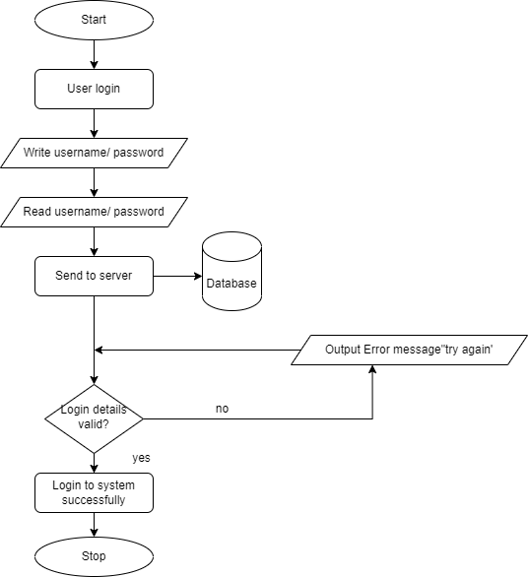
Back-End
Design:

Slide 41
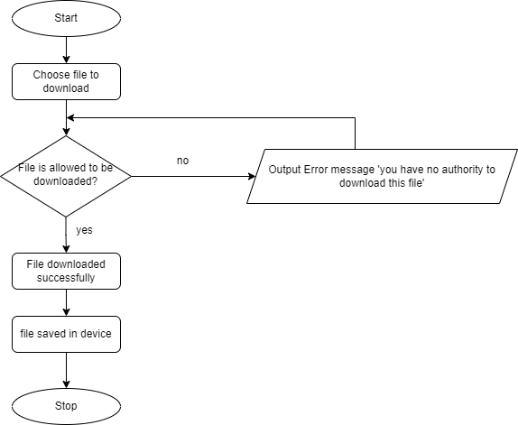
Back-End
Design:

Slide 42
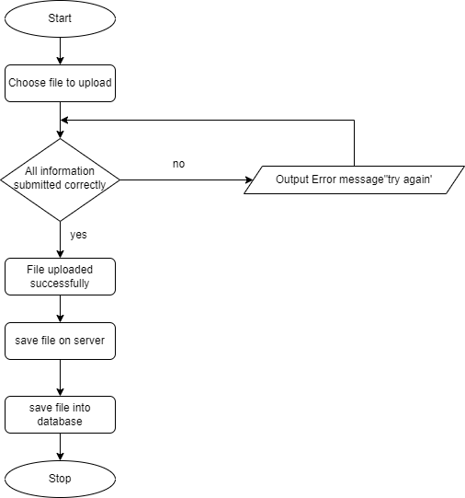
Back-End
Design:

Slide 43
References

Slide 44
References:
1. Abraham, (2009). Autonomic Clouds on the Grid.
Journal of Grid Computing, 1-18.
2. Aderemi A. Atayero*, Oluwaseyi Feyisetan**.
(October 2011). Journal of Emerging Trends in
Computing and Information Sciences. Security
Issues in Cloud Computing: The Potentials of
Homomorphic Encryption. VOL. 2 (NO. 10), p
547-550.
3. Andrew Tabona. (2013). The Top 20 Free Network
Monitoring and Analysis Tools for Sys Admins.
Available: http://www.gfi.com/blog/the-top-20-freenetwork-
monitoring-and-analysis-tools-for-sysadmins/.
Last accessed 2nd November 2014.
4. Armbrust, M., Fox, A., Griffith, R., Joseph, A., Katz,
R., Konwinski, A., Lee, G., Patterson, D., Rabkin, A.,
Stoica, I. and Zaharia, M. (2009). Above the Clouds:
A Berkeley View of Cloud Computing. Technical
Report. University of California at Berkeley.
10. CN VR. (17 September 2014). The Raspberry Pi B.
Available: http://www.ebay.com/itm/CN-Ver-
Raspberry-Pi-2-0-Model-B-512MB-ARM11-Linux-
System-Development-Board-Kit-/261189408347.
Last accessed 11 October 2014.
11. David Oven. (2013). Ethernet Tutorial - Part I:
Networking Basics. Available: http://www.lantronix.
com/resources/net-tutor-etntba.html. Last accessed
2018th November 2014.
12. Foster, I., Zhao, Y., Raicu, I. & Lu, S. (2008). Cloud
Computing and Grid Computing 360-Degree
Compared, University of Chicago, 10-56.
13. ICO. (2013, Jul.) “Privacy impact assessment
handbook,” v2.0, Information Commissioner’s
Office, UK. [Online]. Available: http:
//www.ico.org.uk/pia handbook html v2/files/
PIAhandbookV2.pdf
14. ipv6launch.org. 2012. IPV6launch. [ONLINE]
Available at: http://www.worldipv6launch.org/
support/. [Accessed 09 April 2018].
15. jaipa.or.jp. 2011. Current status and the future
direction of IPv6 in Japan. [ONLINE] Available at:
http://www.jaipa.or.jp/ipv6day/data/111121_iaetf.
pdf. [Accessed 09 April 2018].
16. James Hilton. (June, 2013). Designing and Building
the Best Small Office Network From the Ground Up.
Available: http://www.networkcomputing.com/
netdesign/soho1.html. Last accessed 2018th
November 2014.
5. Bessie. (December 2012). Ouya vs Raspberry Pi.
Available: http://ouyaforum.com/showthread.php?
755-Ouya-vs-Raspberry-Pi. Last accessed 11
October 2014.
6. Boniface, M., Nasser, B., Papay, J., Phillips, S.,
Servin, A., Yang, X., et al. (2009). Platform-as-a-
Service Architecture for Real-time Quality of Service
Management in Clouds.
7. Christodorescu, M., R. Sailer, D. L. Schales, D.
Sgandurra, and D. Zamboni (2009). Cloud security
is not (just) virtualization security. In Proceedings of
the ACM Cloud Computing Security Workshop
(CCSW), pp. 97–102.
8. Cisco. (2013). Cisco Packet Tracer. Available:
http://www.packettracernetwork.com/. Last
accessed 2018th November 2014.
9. Cloud Security Alliance, “Top Threat to Cloud
Computing V1.0,” March 2010. [Online]. Available:
https://cloudsecurityalliance.org/topthreats/csathrea
ts.v1.0.pdf

Slide 45


Thank You

